Slide 1
Introduction to LaTeX
Håkon M. Bjerkan and Kari Ø. Frafjord
Academic librarians – contact persons for TN
12.09.2023

Slide 2
Program
What is LaTeX?
The workflow – LaTeX vs. Word
Create a template for later use

Slide 3
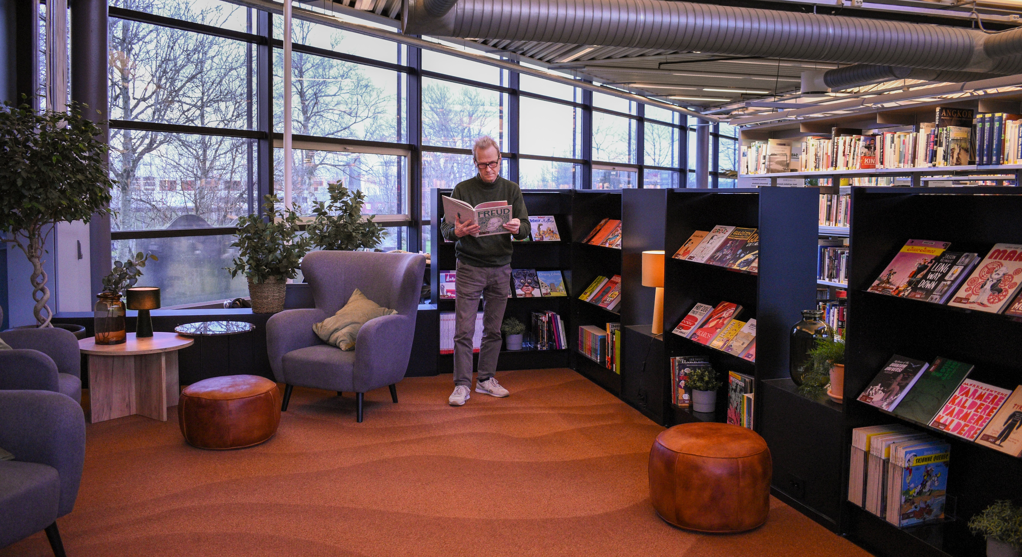
The best way to learn LaTeX is by trying it out yourself!

Slide 4
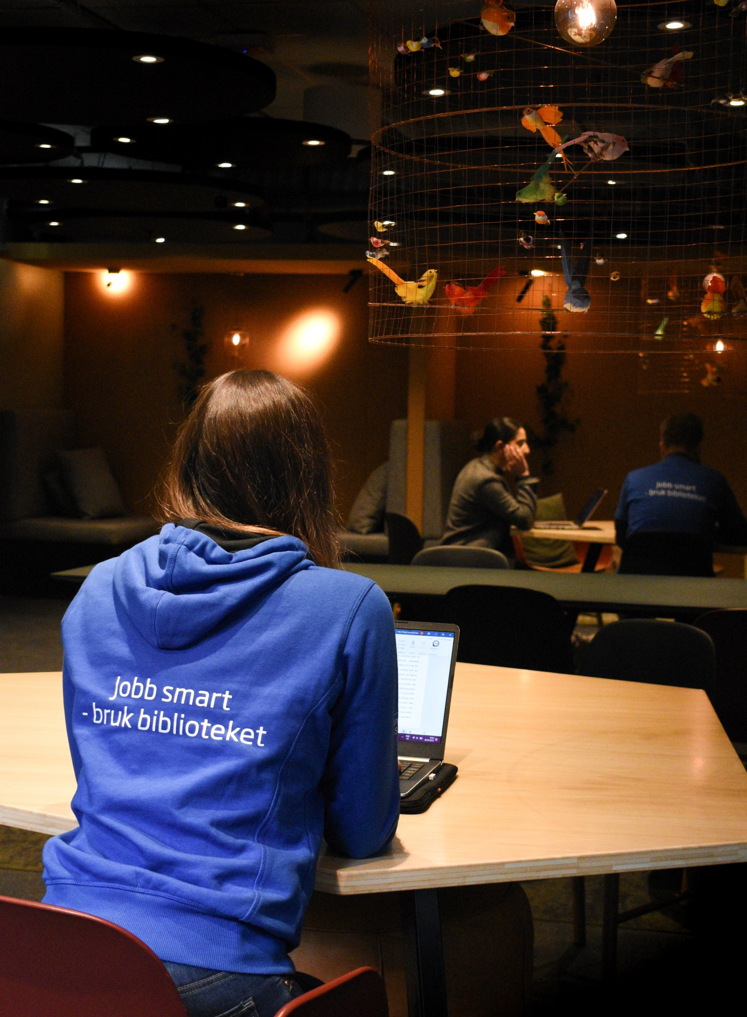
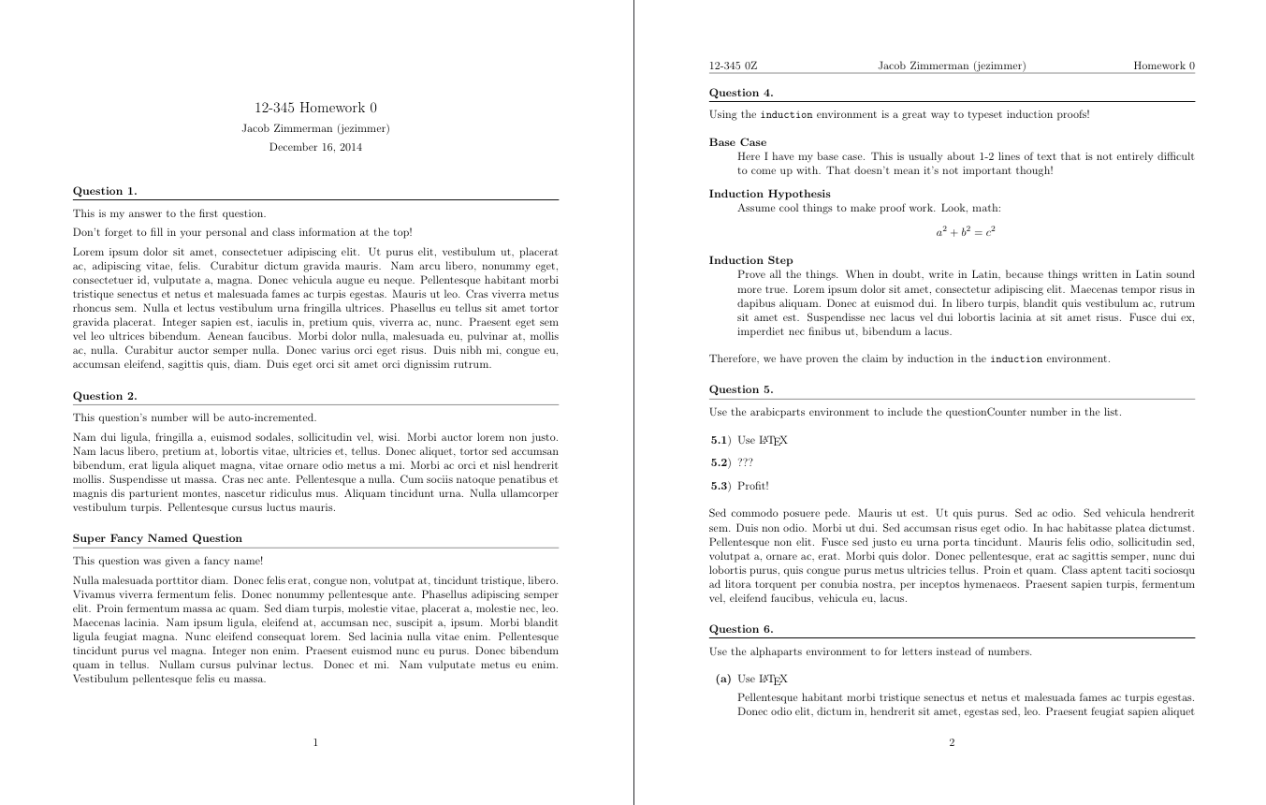
What is LaTeX?
and when is LaTeX a good alternative?
A text-editing program
Used instead of Microsoft Word, Google Docs, OpenOffice etc.
You have more control over your document and spend less time on formatting
Well-suited for larger assignments/thesis and if the document includes equations, figures, tabels, cross references, references etc.

Slide 5
LaTeX vs. Microsoft Word
LaTeX | Microsoft Word etc.
«What you see is what you mean» | «What you see is what you get»
Requires some effort to get started | Requires minimal effort to use, but structuring a thesis takes time
Allows you to focus on content | Frequent adjustment/formatting
Good system for equations, figures, tables, cross references and references

Slide 6
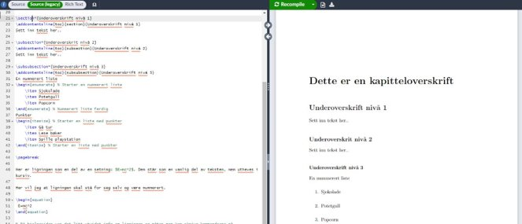
How does it work?
The workflow when using LaTeX
.tex-file
Edit source file in Overleaf
«Compile» source file
Check result
(PDF-file)
.pdf-file

Slide 7
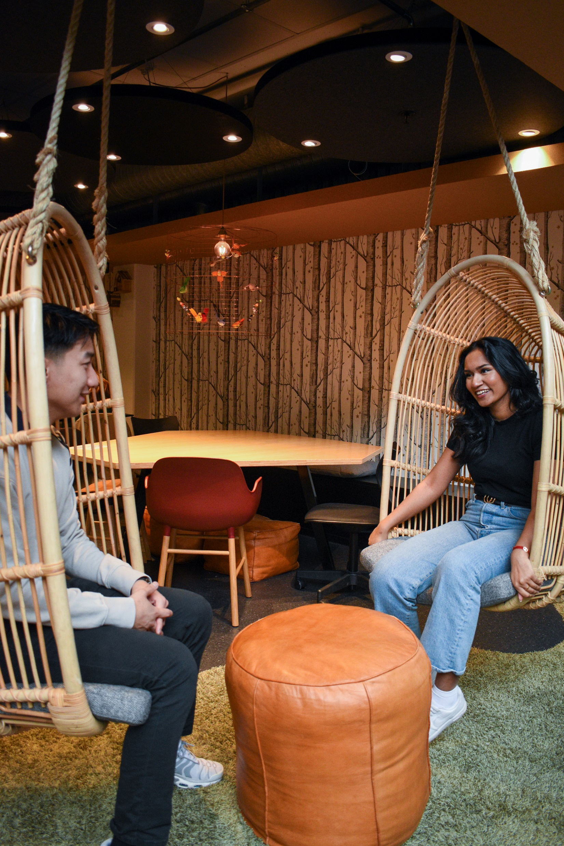
Troubleshooting
Common errors are:
Typing errors in commands
Missing \ , { , } or [ , ]
Missing \begin{..
Missing \end{..
Incorrect file path

Slide 8
How to interpret errors
Two types of errors:
Yellow: «warning»
Red: «error»
Which type of error do you get?
What does the error say?
Which line?

Slide 9
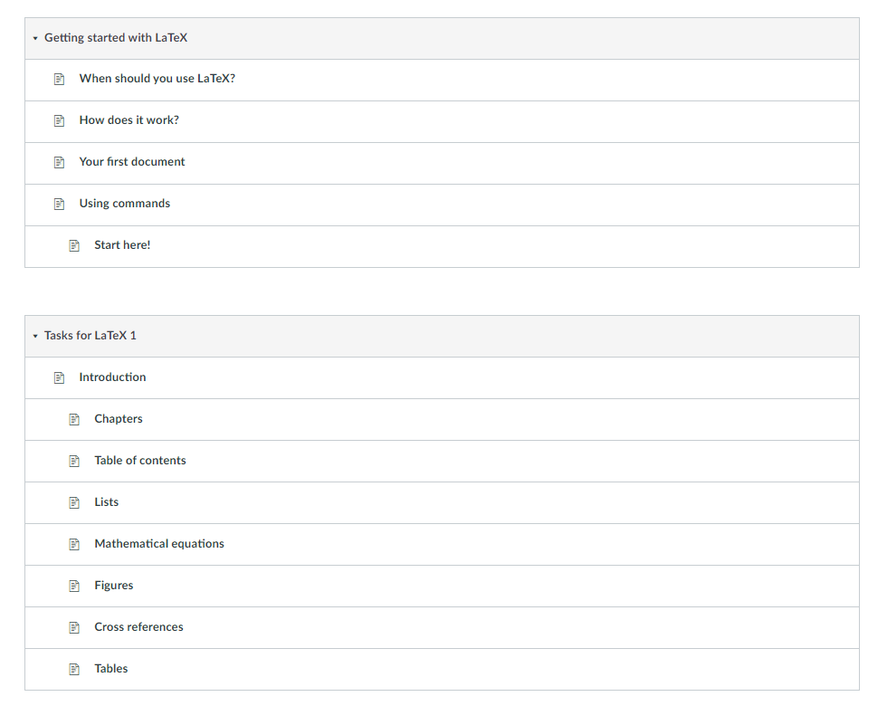
Now it's your turn to try!
Find the LaTeX help pages in Canvas and go through the modules:
«Getting started with LaTeX» and «Tasks for LaTeX 1»

Slide 10
Useful resources
LaTeX help pages in Canvas
The University Library course calendar
The Study Lab – get help from student mentors with academic writing
Learning Support Center – get individual guidance if you experience academic challenges
Citation Compass – helps you cite sources and critically evaluate sources
Søk & Skriv – get help getting started on your thesis writing
Podcast about academic writing
Remote access
ub@uis.no

Slide 11
Thank you for your attention
and good luck with LaTeX!

